Slide 1
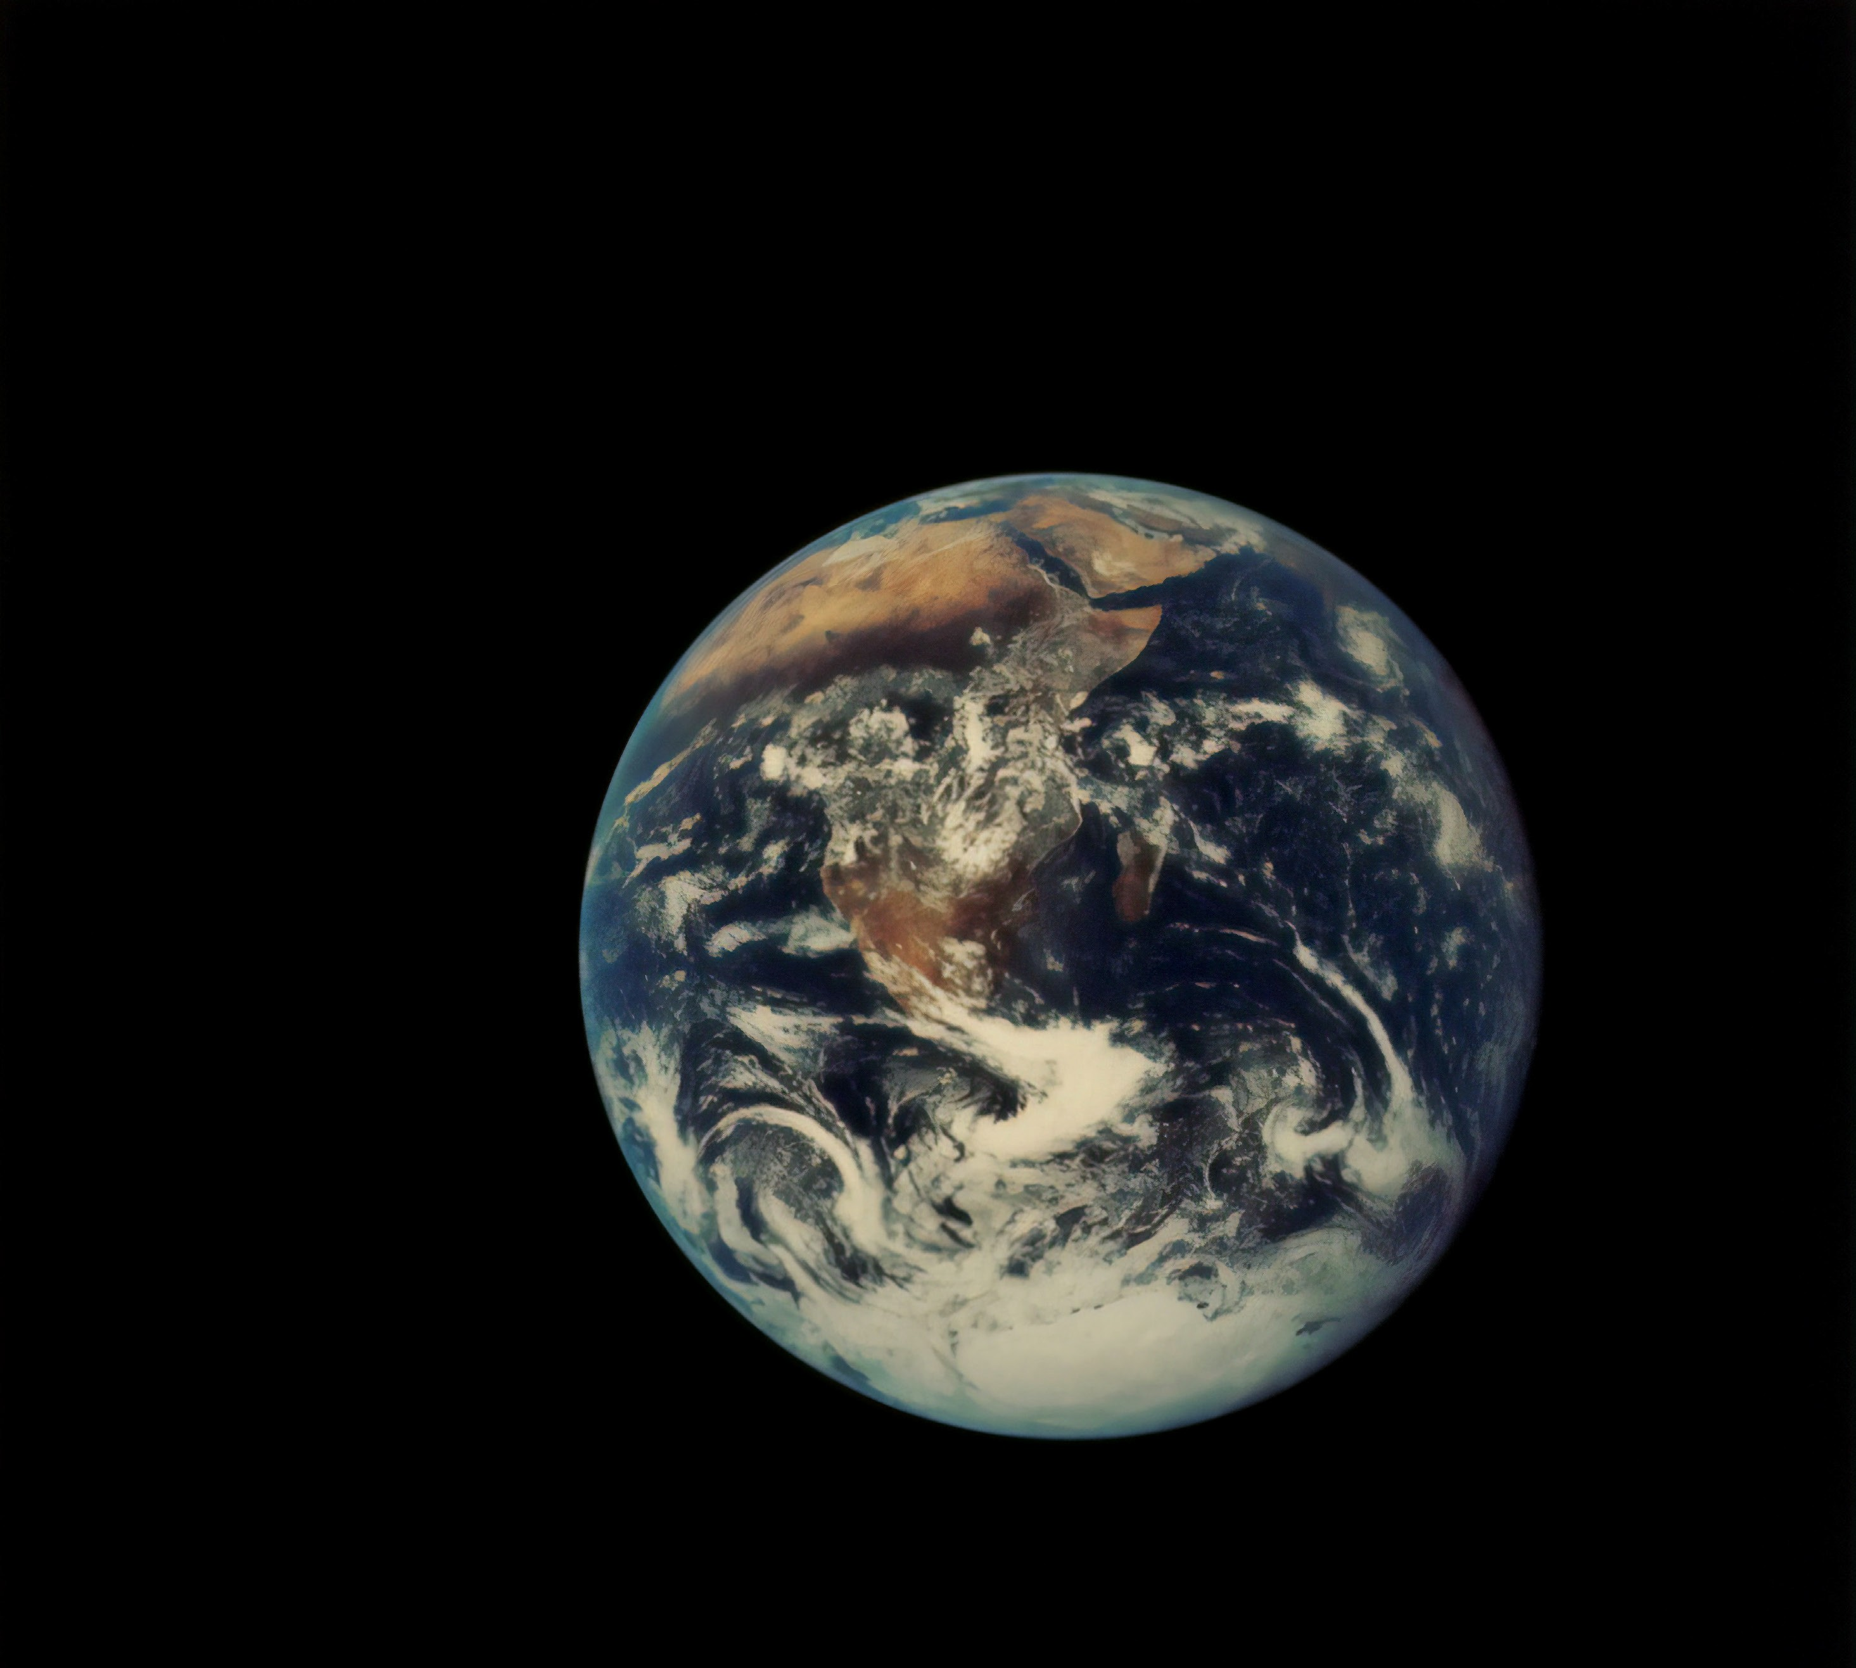



Spotlight from Space: Taking the Earth’s Temperature

Slide 2
Learning Outcomes
I can identify the characteristics of a satellite
I can build my own satellite model
I can explain why temperature changes over time and how humans impact climate change
I can decide on a positive climate action

Slide 3
Activity 1

Slide 4





Watch this video and answer
What is a satellite?
Where is it?

Slide 5
Activity 2

Slide 6
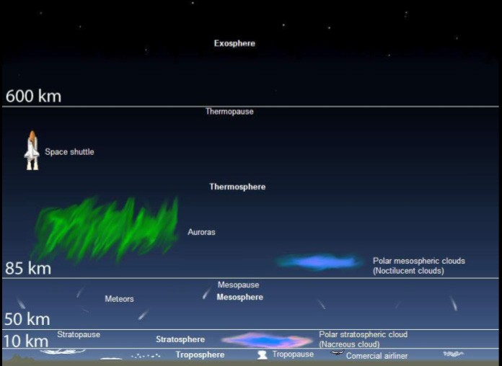

Slide 7
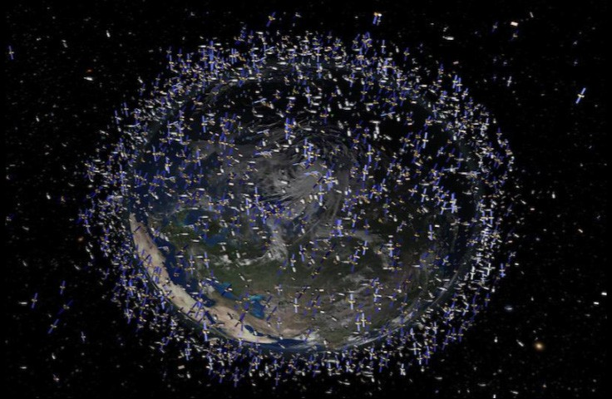

Slide 8
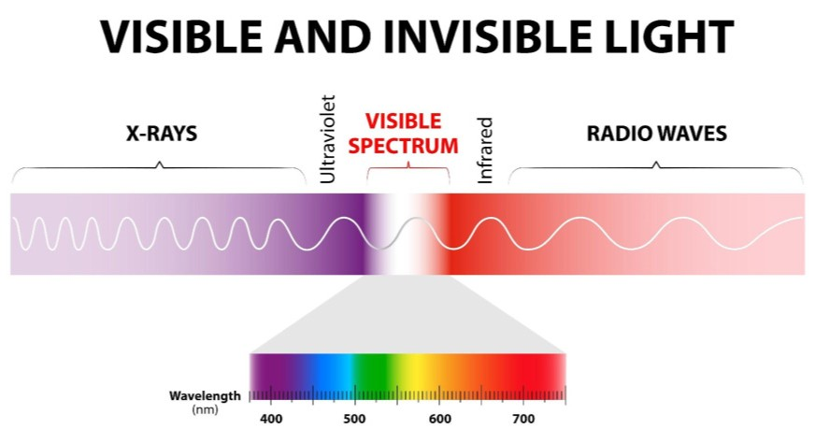

Slide 9
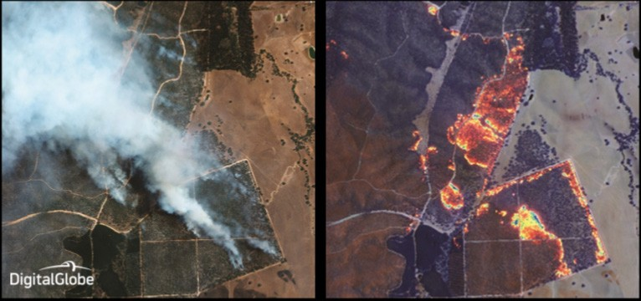

Slide 10
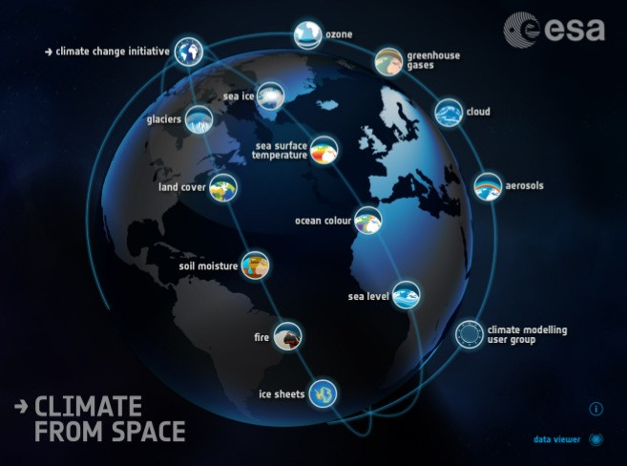

Slide 11
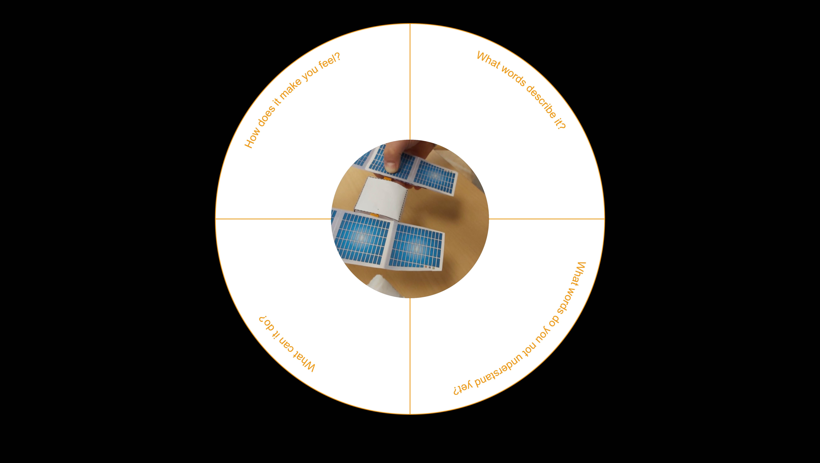



Slide 12
Activity 3

Slide 13
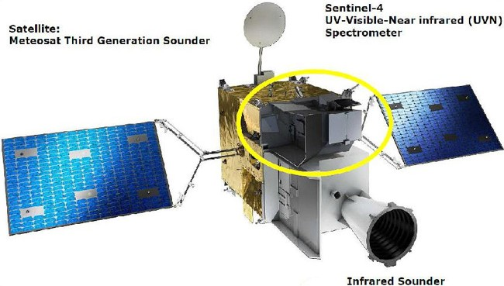

Slide 14
Build your satellite

Slide 15
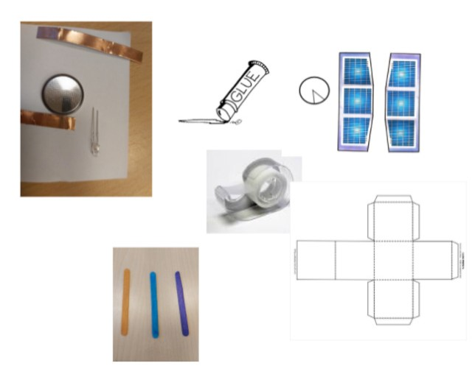
Materials to build your model using LED light
Per student
CR2032 Coin Cell Battery
2 small pieces of copper tape
1 LED – blue or ultraviolet Color
Project Template
3 Popsicle sticks
Make sure you have enough:
Copper tape w/ conductive adhesive or aluminium foil
Tape
Glue stick
Scissors

Slide 16
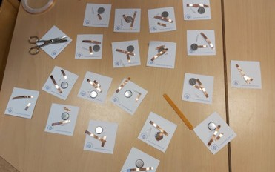
Materials to build your model using LED light
Suggestion: have one set ready per student before you start the lesson:
1 LED light
2 pieces of copper tape
1 coin battery
1 worksheet of template 1 & 2

Slide 17
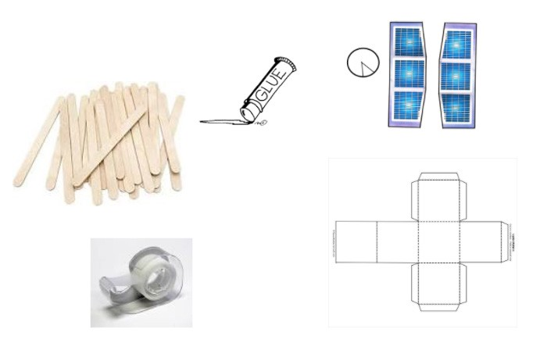
Materials to build your model using LED light
Per student
Project Template
3 Popsicle sticks
Make sure you have enough
Tape
Glue stick
Scissors

Slide 18
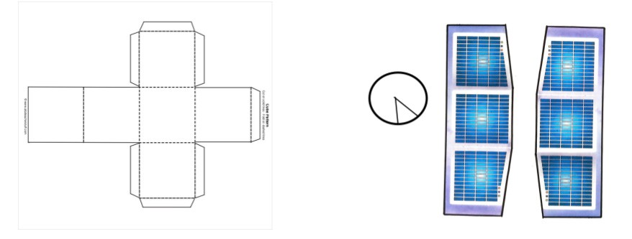
Step 1
Print Project Templates
You can find them in the appendix

Slide 19
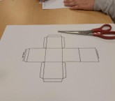
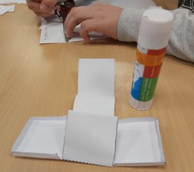
Step 2
Cut on solid lines
Fold on dashed lines
Paste

Slide 20
Step 3
Cut Solar panels

Slide 21
Step 4
Glue the popsicles together

Slide 22
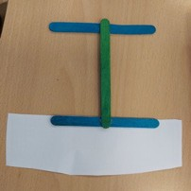
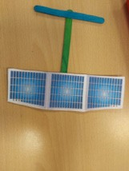
Step 5
Glue solar panels to the popsicles

Slide 23
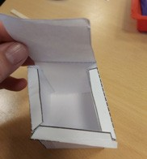
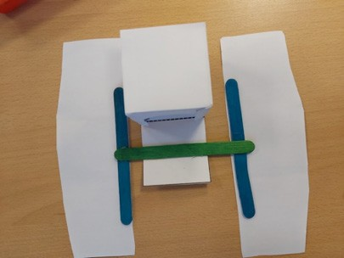
Step 6
Attach the solar panels to the cube

Slide 24
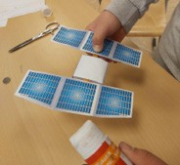
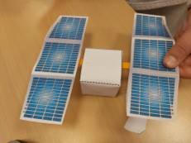
Step 6
Attach the solar panels to the cube and glue the last part of the cube

Slide 25
If you want to add the LED light follow the
next instruction

Slide 26
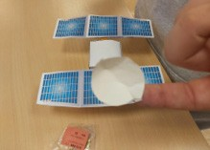
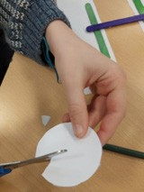
Step 7
Cut the circle from template 2 and glue the circle to make it look like an antenna.

Slide 27
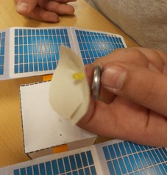
Step 9
Insert the LED light in the middle of the antenna

Slide 28
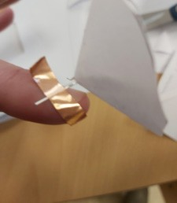

Step 10
The next step is to mount the LED light.
Identify which leg is positive and negative. The longer leg is the positive (+) and the short leg is (-) negative.
Bend the legs at a 90 degree angle.
Attach the copper tape to the positive leg and stick it to the satellite

Slide 29



Step 11
Attach Coin Cell Battery to the satellite.
Cut a small piece of copper tape and roll it up with the sticky side facing the negative site of the battery.
Stick the negative (short) leg of the the LED lamp with the copper tape to the negative side of the battery
The long positive leg needs to touch the positive side of the battery and the negative leg the negative side of the battery and then...
Your satellite has light!!!

Slide 30
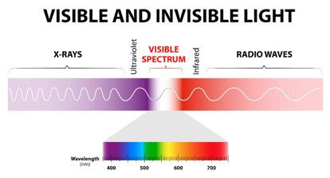
Infrared light
Remember we were talking about infrared light? Imagine that our satellite has infrared light.

Slide 31
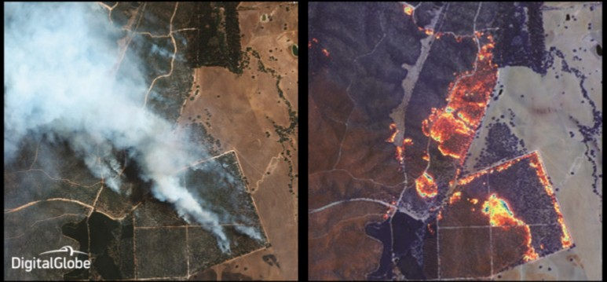

Slide 32
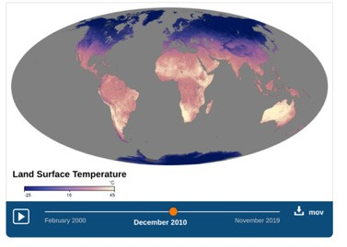
Land surface temperature
Follow this link to find out the land surface temperature of the month you were born in: earthobservatory.nasa.gov/global- maps/MOD_LSTD_M
What changes in temperature do you notice from the day you were born to November 2019?

Slide 33
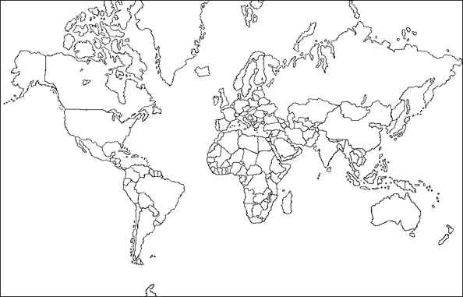

Slide 34
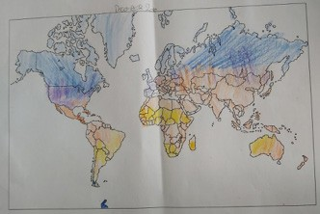

Slide 35
Find an image from a satellite related to climate change and elaborate
Form: What is it like?
Function: How does it work?
Causation: Why is it the way it is?
Connection: How is it connected to other things?
Responsibility: What is our responsibility?
Reflection: How do we know?

Slide 36
Activity 5

Slide 37




Self-reflection
Name: Date:
Criteria | Mastering | Developing | Beginning
Demonstrate knowledge characteristics of satellites | I can explain at least two characteristics of satellites | I can explain at least one characteristic of satellites | I can explain characteristics of satellites with support
Follow a sequence of steps to make a satellite model | I can make a model of how a satellite and explain how to do it. | I can make a model of the satellite. | I can make the model of the satellite with support.
Find patterns on Earth’s temperature | I can mention at least two patterns on Earth’s temperature. | I can mention at least 1 pattern on Earth’s temperature. | I can mention patterns on Earth’s temperature with support.
Discuss the connection between climate change and human impact. | I can mention at least two reasons why humans impact Earth’s temperature. | I can mention at least one reason why humans impact Earth’s. | I can mention why humans impact Earth’s with support.

